Slide 1
Farming, Gardening, Seeds, Soils…
Art Scheele

Slide 2
A short Bio…
Born and raised on a “family farm”…dairy, beef, hogs, chickens, corn, beans, oats, hay, forages, pasture, more…
Three large gardens providing most of our groceries
Farmed 10 years on my own (1973-1983)
Farm, garden seed & soil health business:1978 – present.
Master Gardener 2001- present
Certified organic and non-gmo seed since 2001

Slide 3
Holistic View of Healthy Soils…
getting more for less…

Slide 4
definition…Holistic
(Philosophy)
viewpoint/worldview
Characterized by comprehension of the parts of something that is intimately interconnected and explained only by reference to the whole.
dictionary.com

Slide 5
My personal motivation
The American people do not relate their habits of eating to their health…We eat more and more but we are only getting calories without vitamins, minerals and enzymes. We are overweight and sick because we consume ‘foodless’ foods.
[Our health, or lack thereof, is self-directed…as]
Better Health Research, Copyright 2010, PO Box 219, Warrior, AL, entitled Turn Back the Clock: Reverse Aging With Nutrition & Live a Better Life.

Slide 6
4 Design Laws of the Physical World
1) Everything is Connected to Everything Else
“touch one and you touch them all”
2) Everything Goes Somewhere (there is no “away”)
3) No Free Lunch
4) Nature Bats Last
(paraphrase) 4 Rules of Ecology…Barry Commoner, 1917

Slide 7
Everything is connected to everything else
Observing the Creative Design

Slide 8
Why is it important to think with a holistic or Design mindset…?

Slide 12
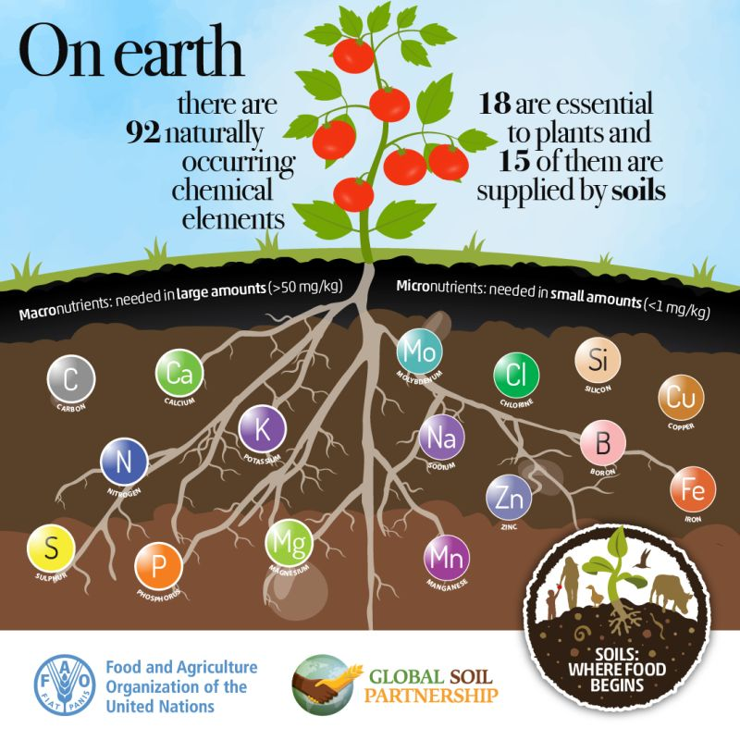

Slide 13
Character Traits of Natural Design
Modesty…nature abhors bare soil
Diversity…mono-culture is not part of the playbook
Wisdom…observe and learn

Slide 14
General Components of Soil
25% air
25% water
40% minerals, clay particles and the multiplicity of ‘livestock’
5% organic matter

Slide 15
Particle size
Profile

Slide 16
Soil is a living (holistic) ecosystem, and is our most precious asset.
Its productive capacity is directly related to its “health”.
(paraphrase) Howard Warren Buffett

Slide 17
There’s a lot going on in the soil…
EARTHWORMS…25 per square foot of soil equal 1 million earthworms per acre.
Studies in England have shown that in healthy soil forty tons of castings per acre pass through earthworms bodies daily. (This is equivalent to moving the top 6” of soil every month.)
A new USA study indicates 12 million worms per acre which move 20 tons of earth each year.

Slide 18
More about earthworms…
Worms live where there is food, moisture, oxygen and a favorable temperature (ideal is 55-75 degrees)…
(if they don’t have these things, they go somewhere else…)
Worms can eat their weight in soil each day
Slime, a secretion of earthworms, contains nitrogen.
Nitrogen is an important nutrient for plants.
The sticky slime helps to hold clusters of soil particles together in formations called aggregates.

Slide 19
There is more going on in the soil…fungi

Slide 20
Mycorrhizae fungi

Slide 21
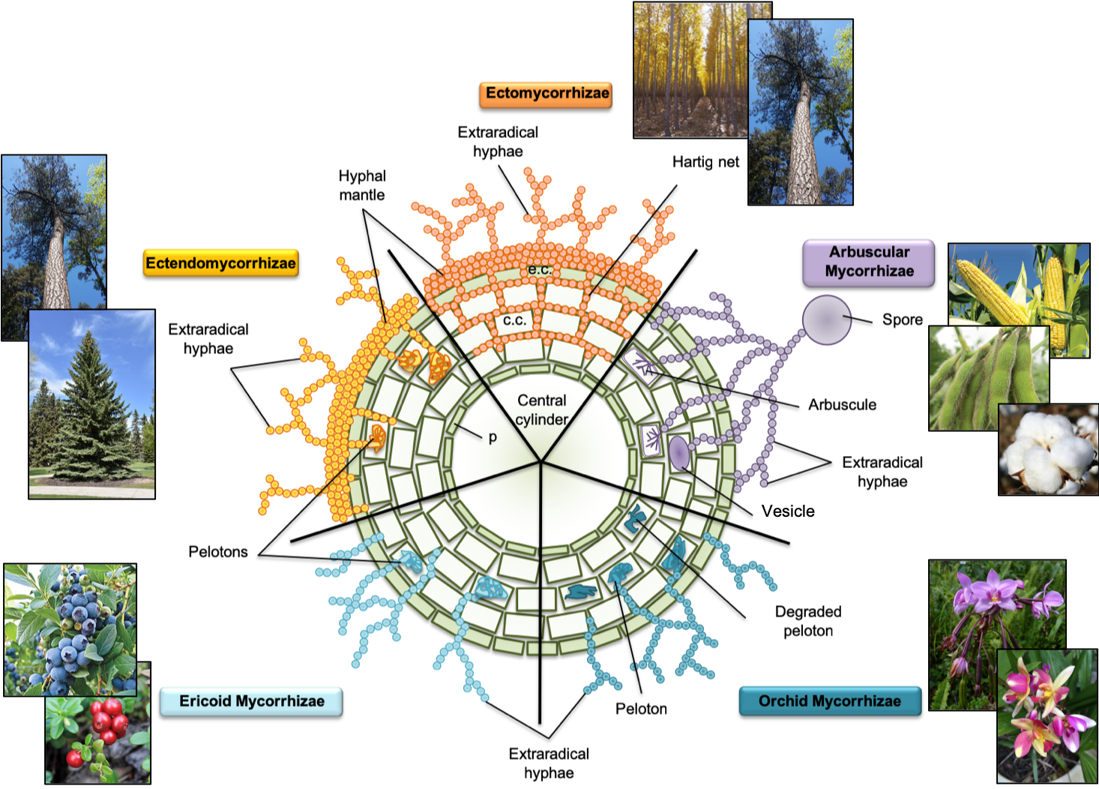

Slide 22
Tillage…
Tillage destroys organic matter
Initially, it creates air pockets, but the fine particles eventually create greater compaction, as well as disrupts earthworm, fungal and biological activity, and more…

Slide 23
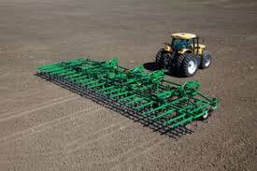

Slide 24
Tillage…Let Nature Do the Work…

Slide 25
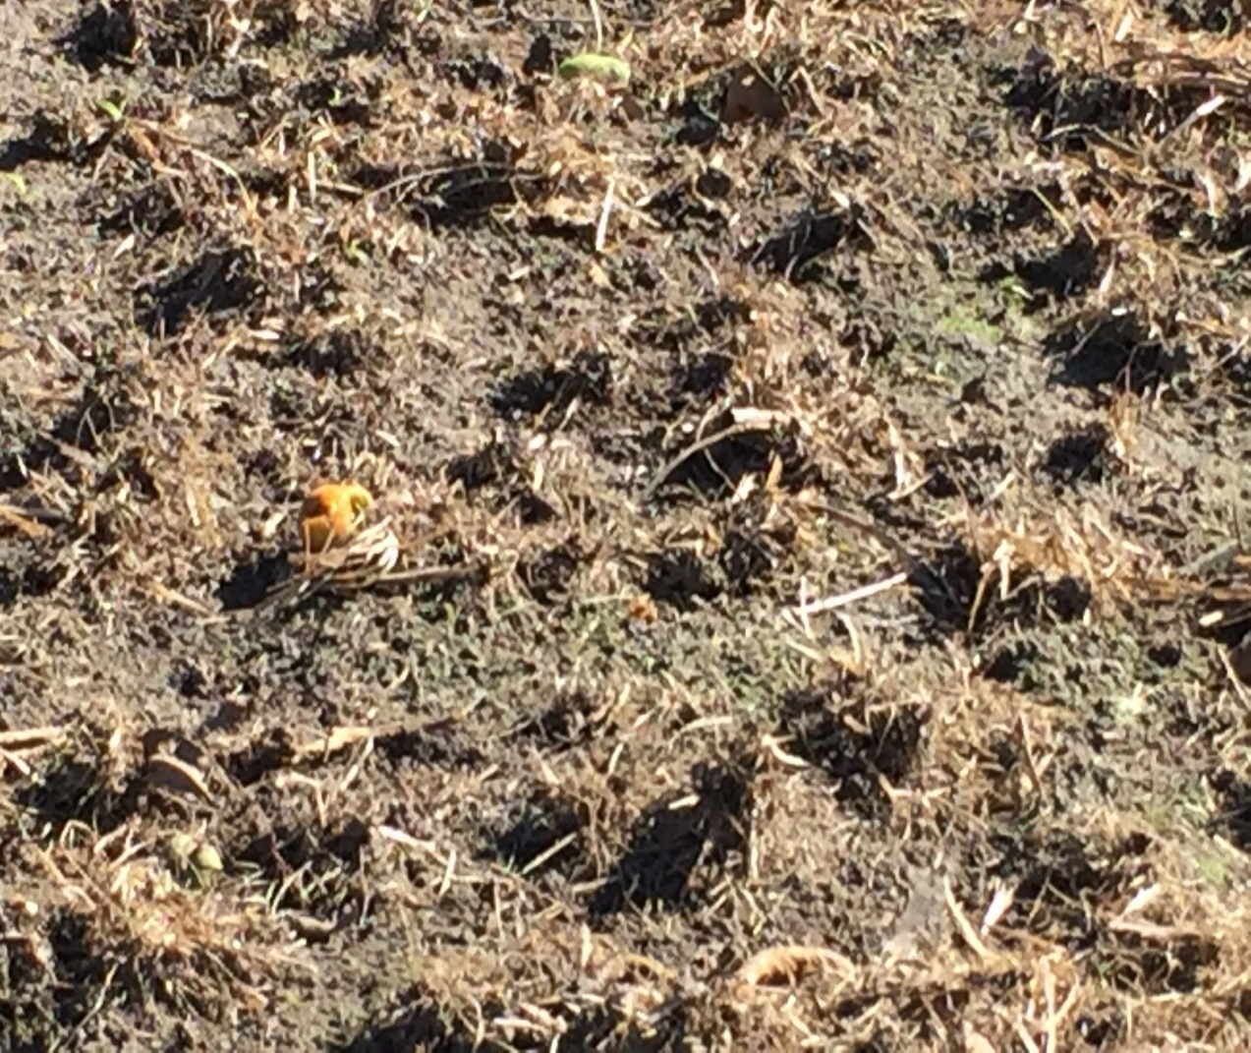
A lot is happening above ground…

Slide 26
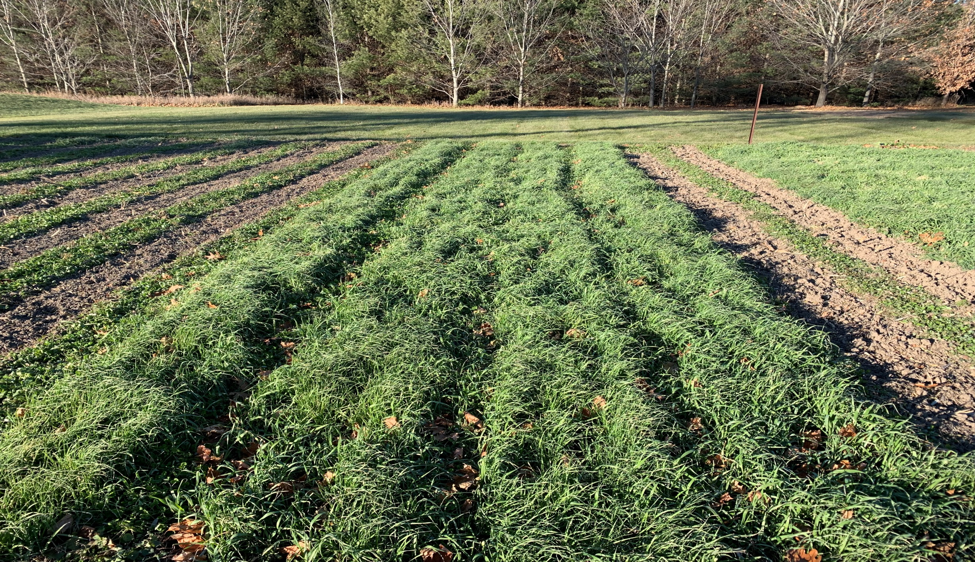

Slide 27
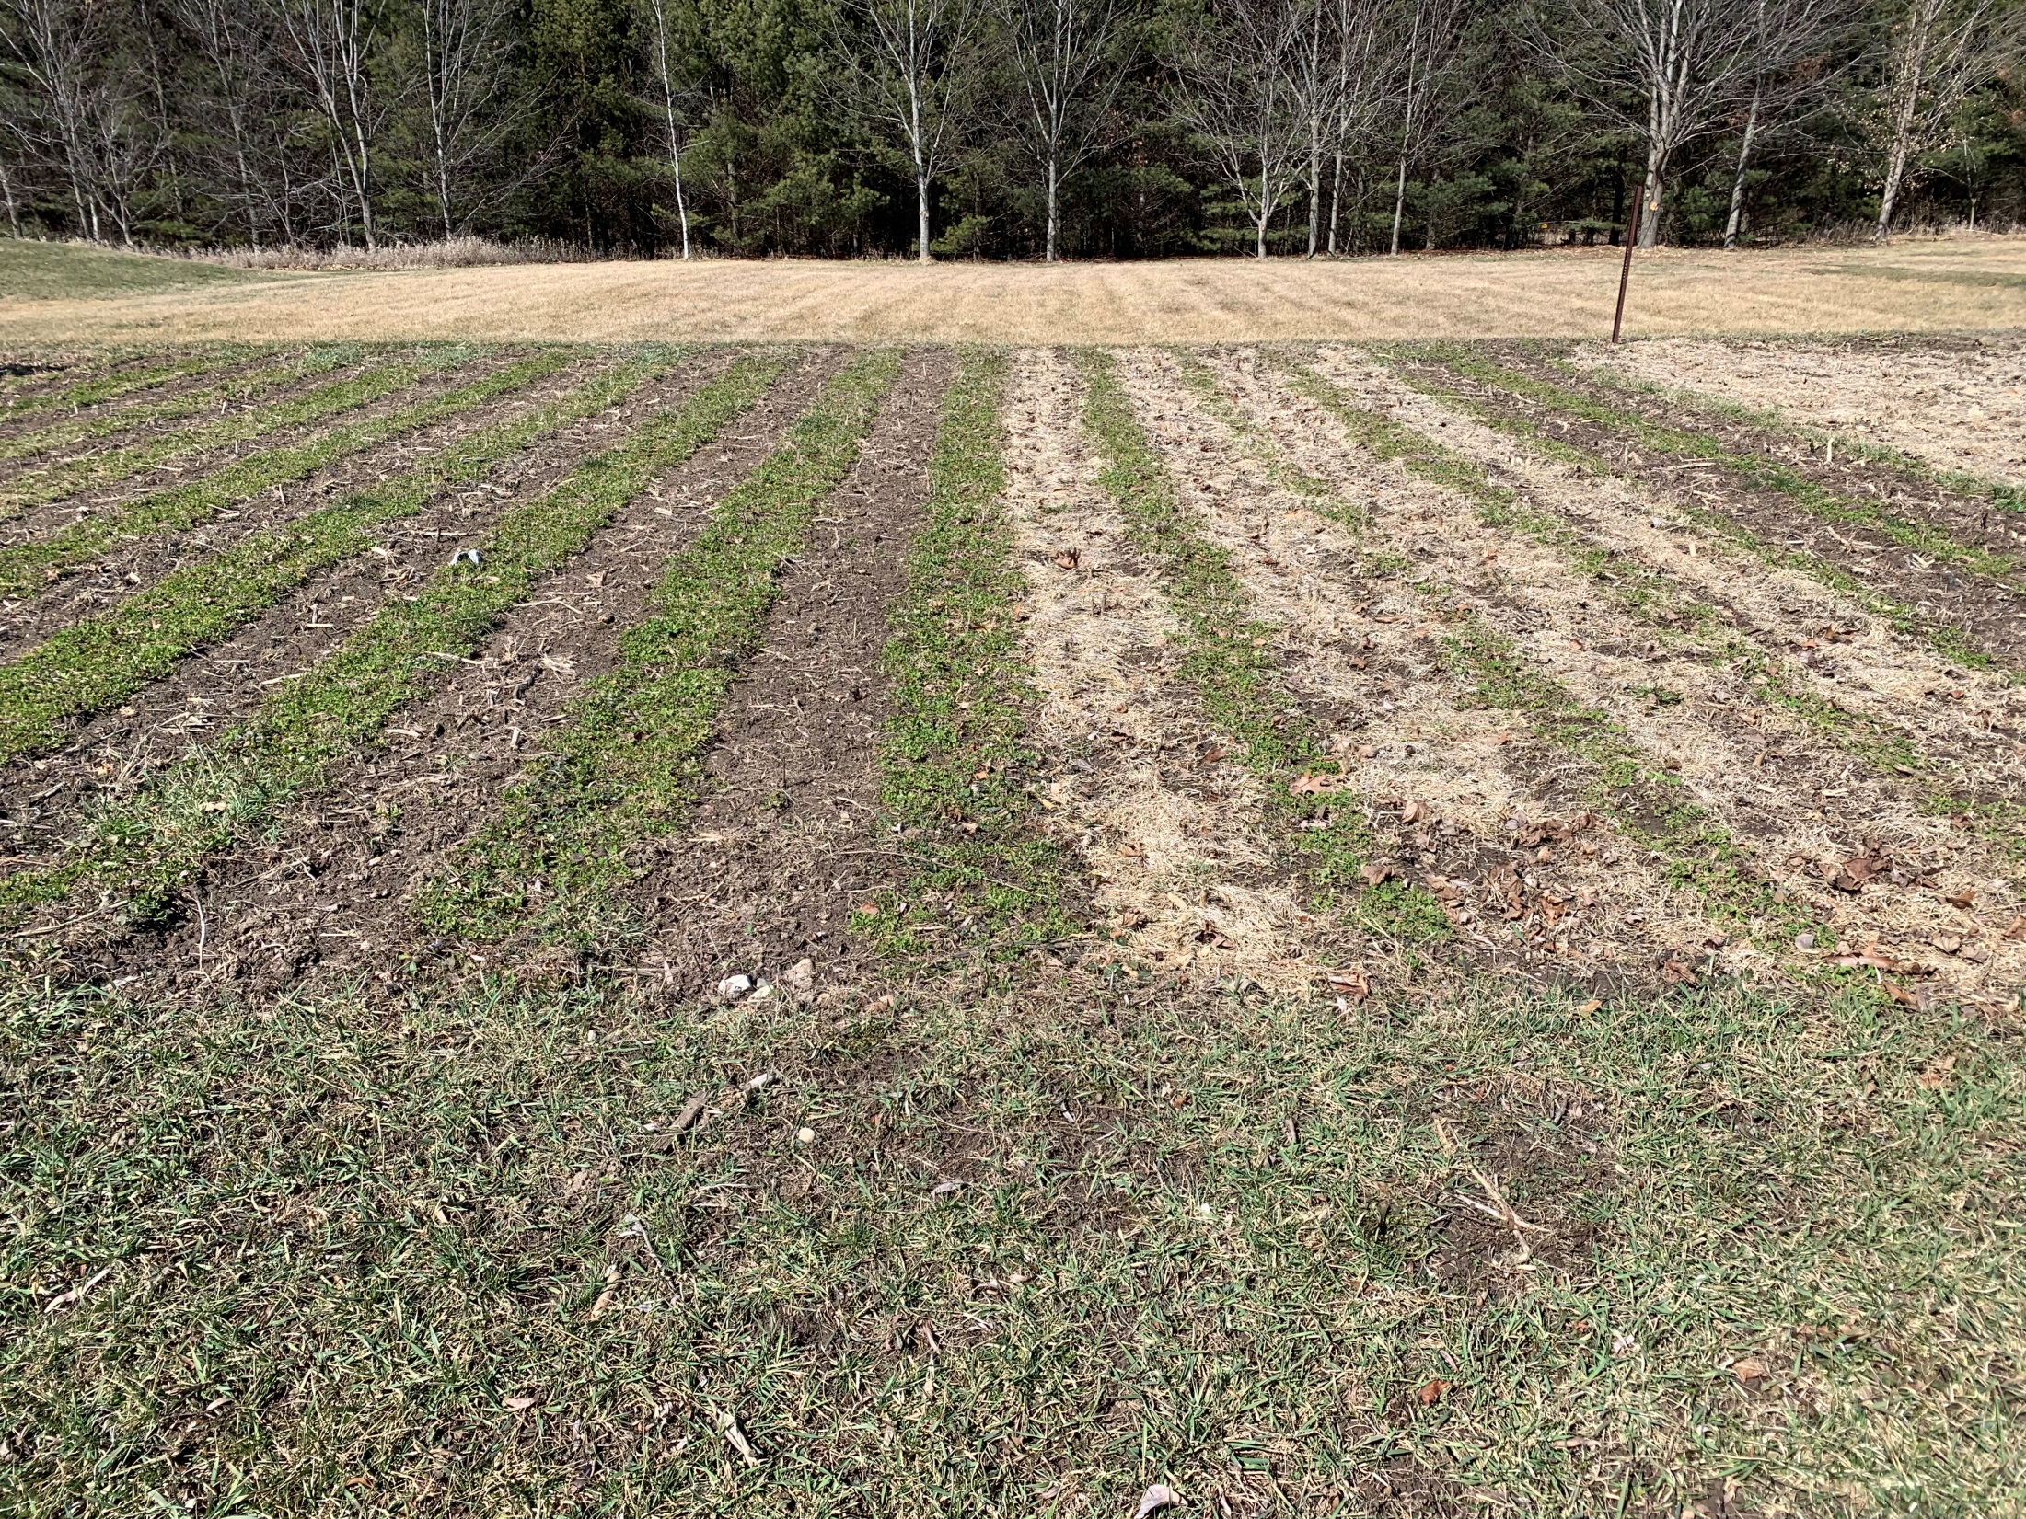

Slide 28
Soil “Livestock” and more…
Earthworms
Mycorrhizae Fungi
Microbes
1 teaspoon of soil… 200 nematodes, 250K algae, 300K amoebae, 100M bacteria
Grubs, snails, slugs, beetles, ants, insect larvae, mushrooms, and many other organisms…
Each have their own interactive designed purpose

Slide 29
Weeding…”if you see weeds, you’ve already lost the battle”
Just because you don’t see weeds doesn’t mean they aren’t there
…and growing!!
Weed 5 days after planting
Weed 9 days after planting
Weed 14 days after planting
(subject to moisture and temperature)

Slide 30
Weeds and other pests…
Weed ‘groups’ are leading indicators of soil mineral imbalances
Insects and disease are part of nature’s design to remove the weak and sickly…
Therefore, weed groups, insects and diseases are indicators and not the ‘real’ problem…

Slide 31
Chemistry…
The suffix ‘cide’ means…’to kill’…
Bio-cide
Pesti-cide
Herbi-cide
Fungi-cide
Bacteri-cide
Just because it says “organic” doesn’t mean it is any safer.
READ the LABELS!

Slide 32
Compost
Know the origin of your compost
Know what it is made of
Livestock manure-based:
Cattle…high in phosphorous, anti-biotics, nitrogen, copper (copper sulfate on OMRI list)
Horse…phosphorous
Chicken…high in Nitrogen, Potassium
Plant material based…walnut (juglone), oak & pine (acidic)

Slide 33
Fertilizer and Soil Amendments
Mineral
Soil test
It’s not about levels of minerals, but solubility
N, P, K, Ca, Mg, S (macros)
B, Mn, Cu, Zn, Fe, Mo (micros)
Biological
Soil test
Bug ‘food’
Endophytes
Biofertilizers:
Rhizobium -inoculate legumes
Azo(to)bacter - ”produce” N
Azospirilium – plant growth
Blue green algae (BGA)
Kelp products

Slide 35
You can't have a healthy civilization without healthy soil. You can't have junk food and have healthy people.
Joel Salatin (Polyface Farm)

Slide 36
Everything is connected to everything else
…brought to us by Creative Design

Slide 37
Could barefoot walking in the grass improve your health? Some research suggests so…
Some of the very same minerals that are found in the earth are also found in your body. Our bodies and our soil are made up of the same exact minerals. Pulling ourselves closer to the soil, and therefore allowing those rich minerals to penetrate into our pores, helps replenish mineral deficiencies and promote overall good health.
healthhttps://homesteadersofamerica.com/benefits-barefoot-gardening/

Slide 38
One reason direct physical contact with the ground might have beneficial physiological effects is the earth’s surface has a negative charge and is constantly generating electrons that could neutralize free radicals, acting as antioxidants. You may think of antioxidants as coming from food, and indeed a diet rich in fruits, vegetables and other foods that provide beta-carotene, selenium, lutein, lycopene and vitamins A, C and E helps prevent cellular damage from free radicals. Still, it is interesting that we may be able to get them directly from the earth, too.
https://www.washingtonpost.com/lifestyle/wellness/could-walking-barefoot-on-the-grass-improve-your-health-the-science-behind-grounding/2018/07/05/12de5d64-7be2-11e8-aeee-4d04c8ac6158_story.html
--------------------------------------------------------------
(The study) also suggests that reconnecting with the earth’s electrons has been found to promote intriguing physiological changes, as well as well-being. Apart from that, when you walk barefoot, then the principles of reflexology work. The point is that your soles are pressed harder, due to which the functioning of your organs gets regulated, but there’s more to it.
https://www.healthshots.com/preventive-care/self-care/5-surprising-benefits-of-walking-barefoot-on-grass/

Slide 39
Questions?

Slide 40
Thank you…

